Slide 1
BOOTCAMP
ACE ENGINEERING COLLEGE
TOPIC : DATA INTELLIGENCE AND AI

Slide 2
Day 7: Introduction to Generative AI & Large Language Models (LLMs)
1. The Basics of Generative AI
What is Generative AI?
Generative AI (GenAI) refers to artificial intelligence systems that can create new content such as:
Text (articles, stories, emails)
Code (Python, Java, JavaScript)
Images (artwork, designs)
Audio and music
Videos
Unlike traditional AI systems that only classify or predict outcomes, Generative AI produces entirely new outputs based on patterns learned from large datasets.

Slide 3
How Does Generative AI Work?
During training, the model analyzes massive amounts of data and learns:
Grammar and language structures
Programming syntax
Image patterns and shapes
Relationships between words and concepts
When given a prompt, the model generates content by predicting what should come next based on its learned patterns.

Slide 4
Example
Prompt:
Write a short poem about nature.
Generated Output:
The gentle breeze whispers low, Through fields where golden flowers grow, Beneath the sky so vast and blue, Nature paints a perfect view.

Slide 5
2. What is a Large Language Model (LLM)?
Definition
A Large Language Model (LLM) is a deep learning model trained on enormous amounts of text data to understand and generate human-like language.
Popular LLMs include:
GPT-4
Gemini
Claude
Llama

Slide 6
How Does an LLM Work?
An LLM predicts the most probable next word (or token) in a sequence.
Example:
Input:
The sun rises in the _____

Slide 7
Possible predictions
Word | Probability
east | 95%
west | 3%
north | 1%
south | 1%
The model selects the most likely continuation.

Slide 8
Another Example
Input:
Artificial Intelligence is
Prediction sequence:
Artificial Intelligence is
→ transforming → the → world → through → automation.
The model generates text one token at a time.

Slide 9
3. Understanding Tokens
LLMs do not process words directly.
Instead, they process tokens, which may be:
A word
Part of a word
A punctuation mark
Example:
Machine Learning is amazing!
Might become:
["Machine", "Learning", "is", "amazing", "!"]
The model predicts the next token repeatedly until the response is complete.

Slide 10
4. The Core API Connection Layout
Most modern LLMs are accessed through APIs.
Step 1: Obtain an API Key
Create an account with an AI provider and generate an API key.
Example:
API_KEY = "your_api_key_here"

Slide 11
Step 2: Install Required Library
For Python:
pip install requests
Pip install yfinance
Pip install kite

Slide 12
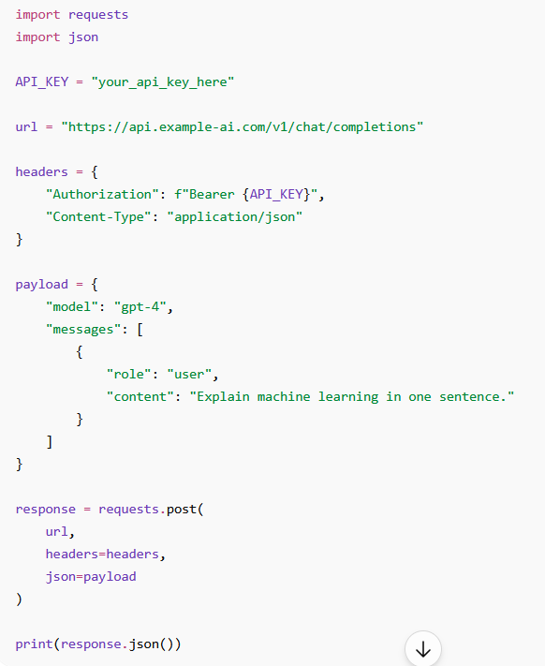
Step 3: Send a Request to the LLM

Slide 13
5. Typical API Workflow
User Prompt ↓ Python Script ↓ API Request ↓ Cloud LLM Server ↓ Generated Response ↓ Python Application ↓ Display Result

Slide 14
6. Example JSON Response
A cloud-hosted LLM often returns data in JSON format:
{ "id": "chatcmpl_123", "object": "chat.completion", "choices": [ { "message": { "role": "assistant", "content": "Machine learning enables computers to learn from data." } } ] }

Slide 15
7. Handling Text Payload Outputs
Accessing the Output
The generated text is usually nested inside multiple JSON levels.
data = response.json()
generated_text = data["choices"][0]["message"]["content"]
print(generated_text)
Output:
Machine learning enables computers to learn from data.

Slide 16
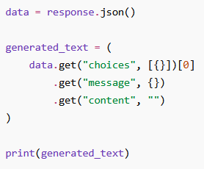
8. Safe JSON Extraction
Sometimes APIs return unexpected structures.
Use .get() to avoid errors.

Slide 17
Key Takeaways
Generative AI creates new content such as text, images, and code.
LLMs are trained on massive datasets and generate text by predicting the next token.
Models such as GPT-4 and Gemini are examples of modern LLMs.
API keys are required to access cloud-hosted LLM services.
LLM interaction follows a request-response pattern using APIs.
Responses are usually returned in JSON format.
Extract text safely from nested JSON using indexing or .get() methods.
Interview Question
Q: Why is JSON parsing important when working with LLM APIs?
A: Because LLM responses are returned as structured JSON objects, and developers must extract the generated text from nested fields before using it in applications.

Slide 18
Assignment 7
Before executing this project install ollama from this link
https://ollama.com/download
git clone https://github.com/codingacharya/assignment7.git
cd assignment7
python -m venv venv
venv\Scripts\activate
pip install -r requirements.txt
ollama pull llama3
ollama serve
streamlit run app.py

